Slide 1
Cortana Intelligence Suite
Transform data into intelligent action

Slide 2
Azure PPE Technical Training
Module 1 – Introducing Cortana Intelligence Suite | Day 1
Module 2 – Information Management
Module 3 – Big Data Stores | Day 2
Module 4 – Machine Learning and Analytics Part 1
Module 5 – Machine Learning and Analytics Part 2 | Day 3
Module 6 – Cognitive Services
Module 7 – Power BI and Power BI Embedded | Day 4
Audience: Architects, Data Scientists and Developers

Slide 3



Big data analytics made easy
Machine Learning and Analytics
Machine Learning
Data Lake Analytics
Data Lake Analytics
HDInsight
(Hadoop and Spark)
SQL DW
SQL DB
Data Lake Store
Storage Blobs
SQL DB in a VM
Stream Analytics
Analyze data of any kind and size
Develop faster, debug and optimize smarter
Interactively explore patterns in your data
No learning curve—use U-SQL, Spark, Hive, HBase and Storm
Managed and supported with an enterprise-grade SLA
Dynamically scales to match your business priorities
Enterprise-grade security with Azure Active Directory
Built on YARN, designed for the cloud

Slide 4
Azure Data Lake Analytics service
A new distributed analytics service
Built on Apache YARN
Scales dynamically with the turn of a dial
Pay by the query
Supports Azure Active Directory for access control, roles, and integration with on-premises identity systems
Built with U-SQL to unify the benefits of SQL with the power of C#
Processes data across Azure

Slide 5
Key benefits of ADL Analytics
Supports Azure Active Directory
Access control
Roles
Integration with on-premises identity systems
Includes U-SQL
Benefits of SQL
Expressive power of C#
Processes data across multiple Azure data sources
U-SQL scalable runtime

Slide 6
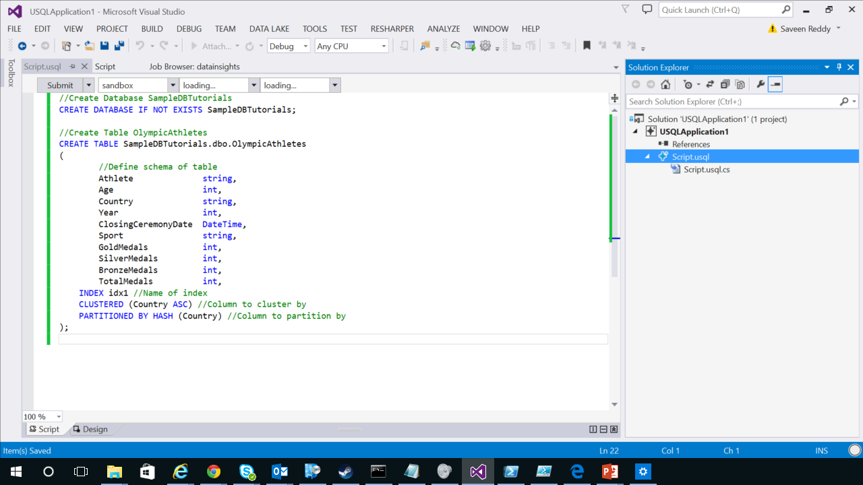
Develop big data applications
Author, debug, and optimize big data applications in Visual Studio
Multiple languages: U-SQL (Hive support coming)
Seamlessly integrate U-SQL with your existing .NET code

Slide 7




Work across all your cloud data
Compute on data anywhere and join data from multiple cloud sources
ADL Analytics

Slide 8
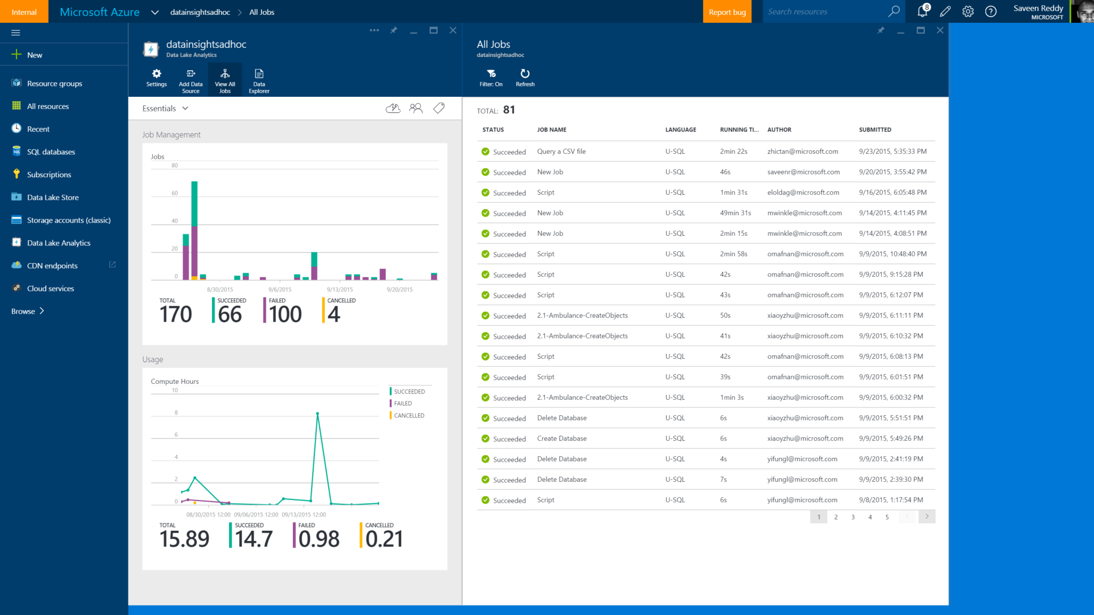
Simplified management and administration
Web-based management in Azure portal
Automate tasks using PowerShell
Role-based Access Control with Azure Active Directory
Monitor service operations and activity

Slide 9
A hyper-scalable, highly extensible language for preparing, transforming, and analyzing all data
Allows users to focus on the what—not the how—of business problems
Built on familiar languages (SQL and C#, SCOPE) and supported by a fully integrated development environment
Built for data developers and scientists
What is U-SQL?

Slide 10

U-SQL fundamentals
All the familiar SQL clauses
Operate on unstructured and structured data
Relational metadata objects
SELECT | FROM | WHERE
GROUP BY | JOIN | OVER

Slide 11
U-SQL queries: General pattern
Read
Process
Store
Azure Storage blobs
Azure Storage blobs
EXTRACT
OUTPUT
Azure SQL DB
SELECT
SELECT… FROM… WHERE…
RowSet
RowSet
EXTRACT
OUTPUT
Azure Data Lake
Azure Data Lake
SELECT
INSERT

Slide 12

.NET integration and extensibility
U-SQL expressions are full C# expressions
Reuse .NET code in your own assemblies
Use C# to define your own:
Types | Functions | Joins | Aggregators | IO (Extractors, Outputters)
U/SQL
.NET

Slide 13
Query across Azure data sources
 | READ | WRITE
Azure Data Lake Store
Azure Storage blobs
Azure SQL database
Azure SQL data warehouse
Azure SQL DB in Azure VM

Slide 14

Visual Studio and U-SQL integration
Author U-SQL scripts (with C# code)
Debug U-SQL and C# code
Submit and cancel U-SQL jobs
Visualize physical plan of U-SQL query
Visualize and replay progress of job
Fine-tune query performance
Create metadata objects
Browse metadata catalog

Slide 15
Read the input, write it directly to output (just a simple copy)
@rows =
EXTRACT
OrderId int,
Customer string,
Date DateTime,
Amount float FROM “/input/orders.txt" USING Extractor.Tsv();
OUTPUT @rows
TO “adl://mylake/orders_copy.txt" USING Outputters.Tsv();
Rowset
Apply schema on read
From a file in a data lake
Easy delimited text handling
Write out

Slide 16
Call intrinsic methods on .NET types
@customers = SELECT Customer.ToUpper() AS Customer
FROM @rows
WHERE Customer.Contains(“Contoso”);
C# expression
C# expression

Slide 17
Use your own C# methods
CREATE ASSEMBLY CustDB.SampleDotNetCode
FROM @"/DLLs/Helpers.dll";
REFERENCE ASSEMBLY CustDB.Helpers;
@rows = SELECT
CustDB.Helpers.Normalize(Customer) AS Customer,
Amount AS Amount
FROM @rows;
Register an assembly
Reference the assembly
Use code from the assembly

Slide 18
Use U-SQL Data Definition Language (DDL) to create tables for high performance
CREATE TABLE Customers(
OrderId int,
Customer string,
Date DateTime,
Amount float);
INSERT INTO Customers
SELECT * FROM @rows;
Define a table
Fill the table with data

Slide 19
Logical plan is converted to a physical plan
@rows =
EXTRACT
OrderId int,
Customer string,
Date DateTime,
Amount float FROM “/input/orders.txt" USING Extractor.Tsv();
OUTPUT @rows
TO “adl://mylake/orders_copy.txt" USING Outputters.Tsv();
SV3 Aggregate Split…
30000 vertices
10.68 s
0 rows
R 2.71 TB W 2.59 TB
4.27 MB
2.59 TB
SV1 Extract
4002 vertices
40.47 s
2569935 rows
SV2 PodAggregate I…
3773 vertices
24.6 s
2569935 rows
SV3 Aggregate Split
2000 vertices
37.78 s
2569777 rows
SV4 Aggregate Int…
7 vertices
13.19 s
0 rows
SV 4 Aggregate
1 vertex
30.70 s
0 rows
Jobfile_ 20150726.txt
Jobfile_ 20150726.ss
R 2.60 TB W 2.60 TB
R 2.60 TB W 2.60 TB
R 2.60 TB W 2.60 TB
R 30.20 MB W 445.30 KB
R 4.71 MB W 345.30 KB
2.60 TB
2.60 TB
30.20 MB
445.30 KB

Slide 20
Compatible Visual Studio versions
Visual Studio 2012
Visual Studio 2013
Including community editions
Visual Studio 2015

Slide 21
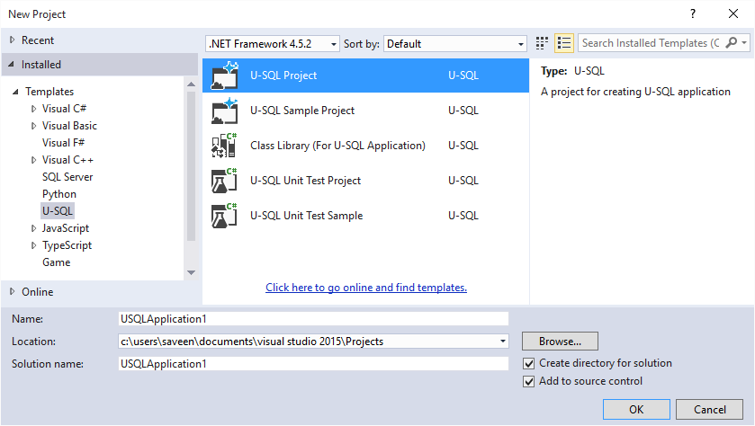
Available project types

Slide 22
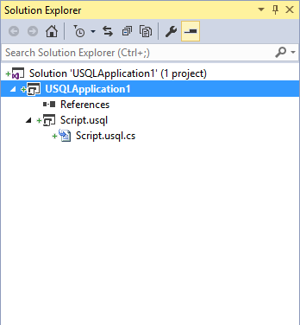
Integration with Solution Explorer

Slide 23
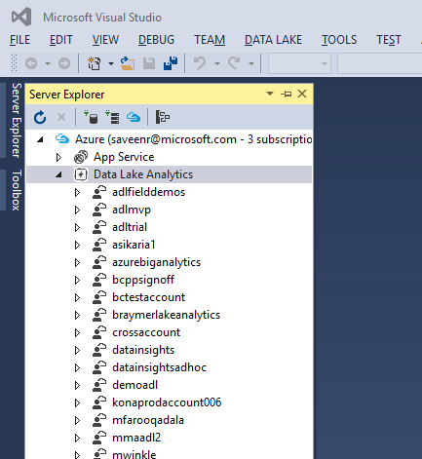
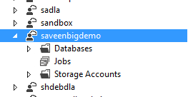
Integration with Server Explorer
Monitor and manage jobs
Browse and manage storage
Browse U-SQL catalog

Slide 24
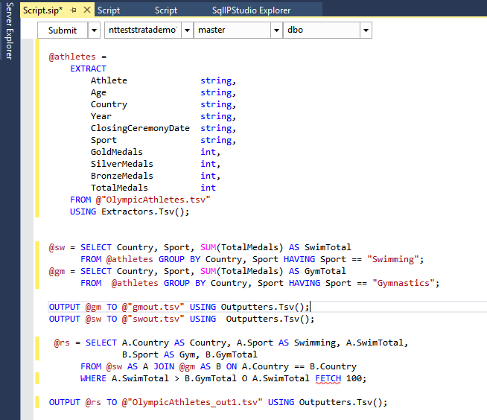
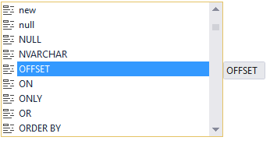

Authoring U-SQL queries
Visual Studio fully supports authoring U-SQL scripts
While editing, it provides:
IntelliSense
Syntax color coding
Syntax checking
contextual menu

Slide 25
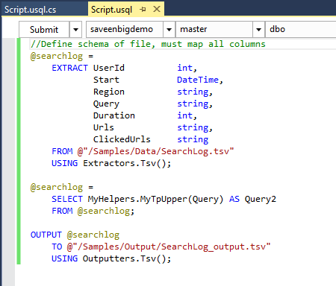
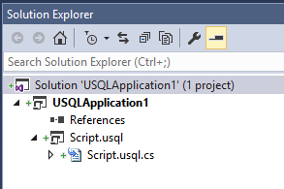
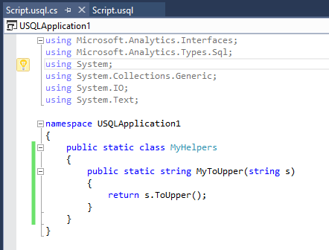
Code-behind files

Slide 26
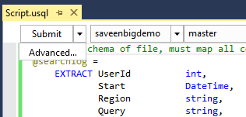
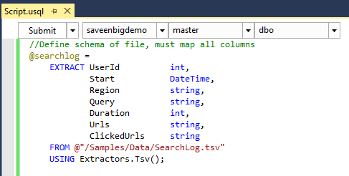
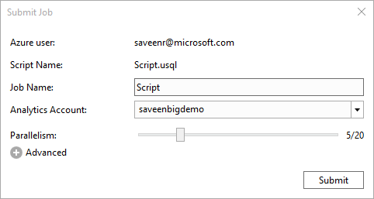
Submitting jobs

Slide 27
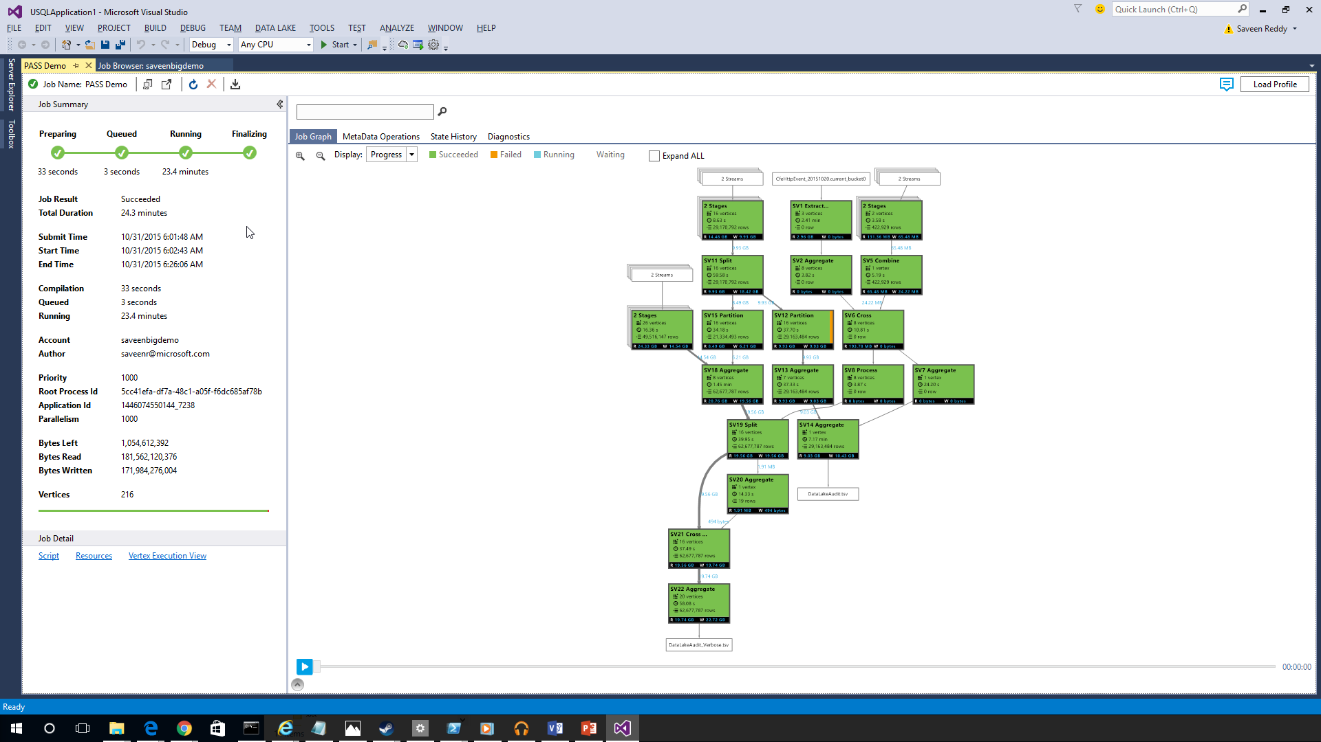
Job execution graph
After a job is submitted, progress of its execution as it goes through the different stages is shown and updated continuously

Slide 28
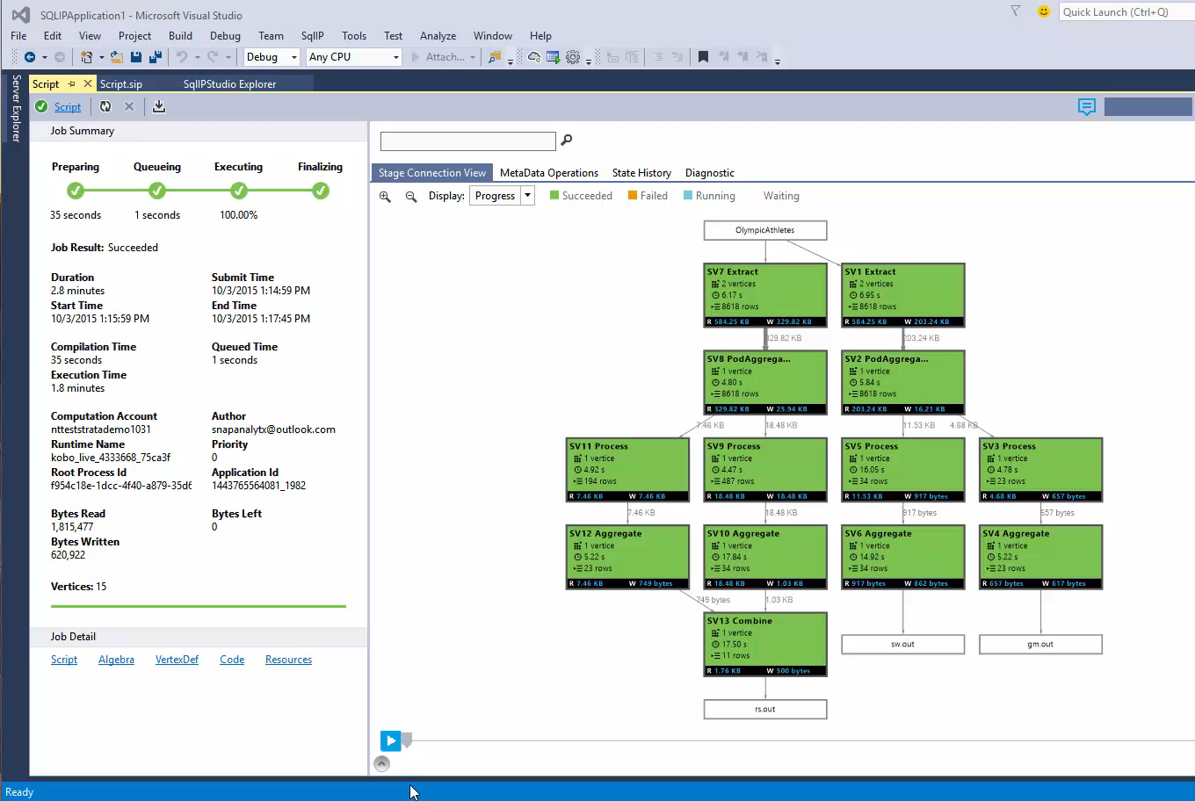
Job execution “progress” playback (video)
For performance tuning, identifying bottlenecks, and debugging, you can play back the job execution graph

Slide 29

Managing performance
Issue detection
Parallelism versus latency analysis

Slide 30
Demo
Show me Azure Data Lake Tools for Visual Studio!

Slide 31
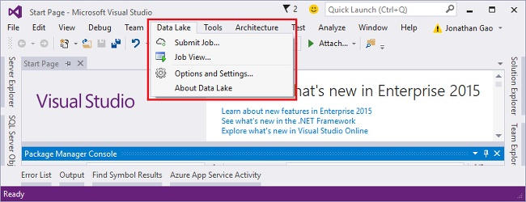

Slide 32
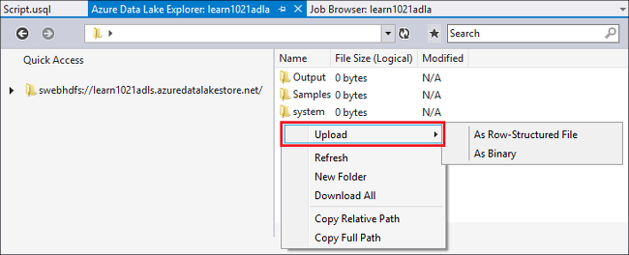

Slide 33
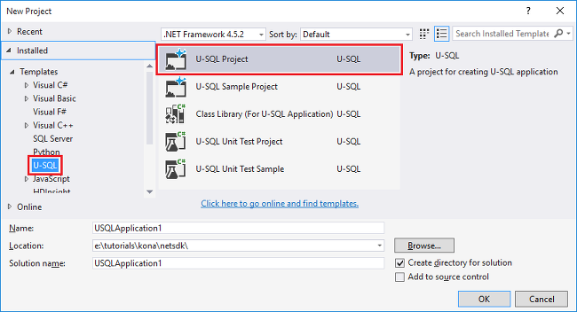

Slide 34
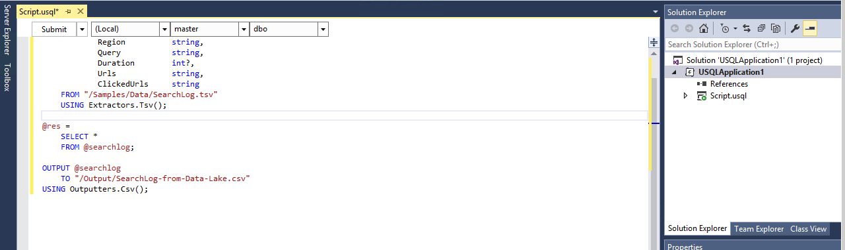

Slide 35
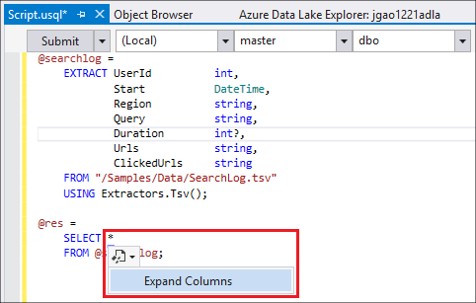

Slide 36
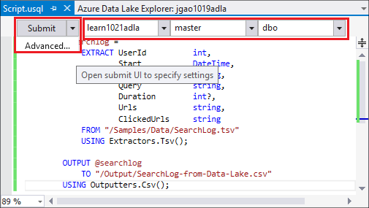

Slide 37
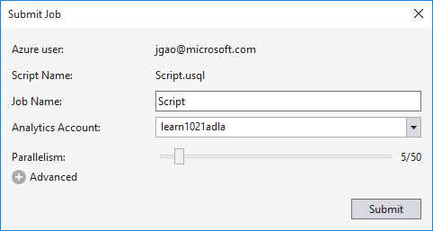

Slide 38
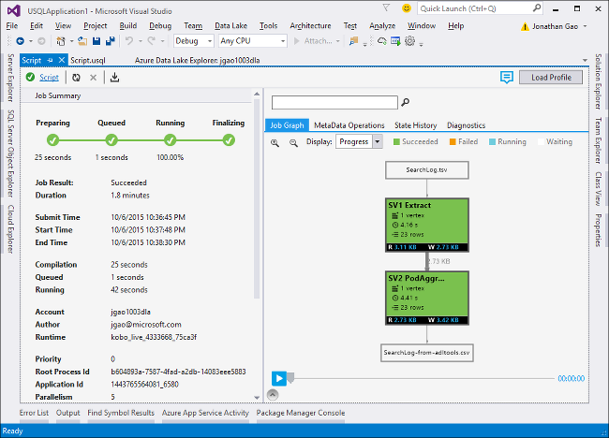

Slide 39
Comprehensive set of managed Apache big data projects
Machine Learning and Analytics
Batch
Map Reduce
Script
Pig
SQL
Hive
NoSQL
HBase
Streaming
Storm
In-Memory
Spark
Machine Learning
Data Lake Analytics
HDInsight
(Hadoop and Spark)
Core Engine
Stream Analytics
Scale to petabytes on demand
Process unstructured and semi-structured data
Develop in Java, .NET, and more
Skip buying and maintaining hardware
Deploy in Windows or Linux
Spin up an Apache Hadoop cluster in minutes
Visualize your Hadoop data in Excel
Easily integrate on-premises Hadoop clusters

Slide 40
Real-time stream processing in the cloud
Machine Learning and Analytics
SQL Database
Machine Learning
Event Hubs
Blob Storage
Event Hubs
Data Lake Analytics
Stream Analytics
Table Storage
HDInsight
(Hadoop and Spark)
Blob Storage
Power BI
Stream Analytics
Perform real-time analytics for your Internet of Things solutions
Stream millions of events per second
Get mission-critical reliability and performance with predictable results
Create real-time dashboards and alerts over data from devices and applications
Correlate across multiple streams of data
Use familiar SQL-based language for rapid development

Slide 41



Intelligence
Information Management
Big Data Stores
Machine Learning and Analytics
Intelligence
Data Sources
Data Lake Store
Machine Learning
Cognitive Services
Data Factory
Bot Framework
SQL Data
Warehouse
Data Lake Analytics
Apps
Data Catalog
Cortana
HDInsight
(Hadoop and Spark)
Event Hubs
Sensors and devices
Stream Analytics
Data

Slide 42




Build applications that understand people
Intelligence
Vision
Speech
Language
Knowledge
Search
Cognitive Services
Computer Vision
Speaker Recognition
Text Analytics
Academic Knowledge
Bing Search API
Bot Framework
Face
Speech
Bing Speller
Entity Linking Service
Bing Image Search API
Cortana
Emotion
CRIS
Web Language Model
Knowledge Exploration Service
Bing Video Search API
Video
Linguistic Analysis
Recommendations
Bing News Search API
Language Understanding Intelligent Service
Bing Auto Suggest API
Faces, images, emotion recognition and video intelligence
Spoken language processing, speaker recognition, custom speech recognition
Natural language processing, sentiment and topics analysis, spelling errors
Complex tasks processing, knowledge exploration, intelligent recommendations
Bing engine capabilities for Web, Autosuggest, Image, Video and News

Slide 43
Vision
From faces to feelings, allow your apps to understand images and video
Computer Vision API
Face API
Emotion API
Video API
Distill actionable information from images
Detect, identify, analyze, organize, and tag faces in photos
Personalize experiences with emotion recognition
Analyze, edit, and process videos within your app

Slide 44

Computer Vision APIs
Analyze an image Understand content within an image
OCR Detect and recognize words within an image
Generate thumbnail Scale and crop images, while retaining key content
Recognize Celebrities Thanks to domain specific models, ability to recognize 200K celebrities from business, politics, sports and entertainment around the World.

Slide 45
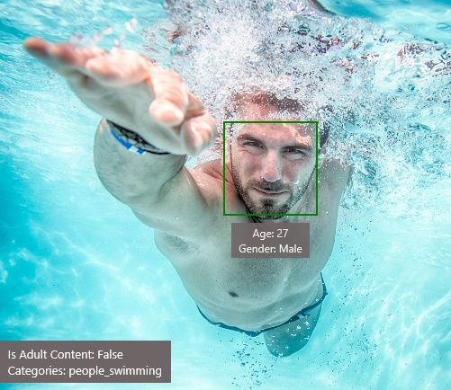
Analyze image
Type of image
Clip Art Type 0 Non-clipart
Line Drawing Type 0 Non-Line Drawing
Black & White Image False
Content of image
Categories [{ “name”: “people_swimming”, “score”: 0.099609375 }]
Adult Content False
Adult Score 0.18533889949321747
Faces [{ “age”: 27, “gender”: “Male”, “faceRectangle”: {“left”: 472, “top”: 258, “width”: 199, “height”: 199}}]
Image colors
Dominant Color Background White
Dominant Color Foreground Grey
Dominant Colors White
Accent Color

Slide 46

OCR
Good at
JSON:
{
"language": "en",
"orientation": "Up",
"regions": [
{
"boundingBox": "41,77,918,440",
"lines": [
{
"boundingBox": "41,77,723,89",
"words": [
{
"boundingBox": "41,102,225,64",
"text": "LIFE"
},
{
"boundingBox": "356,89,94,62",
"text": "IS"
},
{
"boundingBox": "539,77,225,64",
"text": "LIKE"
}
. . .
Scanned documents
Photos with text
Fine grained location information
LIFE IS LIKE
RIDING A BICYCLE
TO KEEP YOUR BALANCE
YOU MUST KEEP MOVING

Slide 47




Smart thumbnail
Smart cropping on
Smart cropping off

Slide 48

Recognize emotions Detect emotions based on facial expressions in photos and videos
Emotion APIs

Slide 49
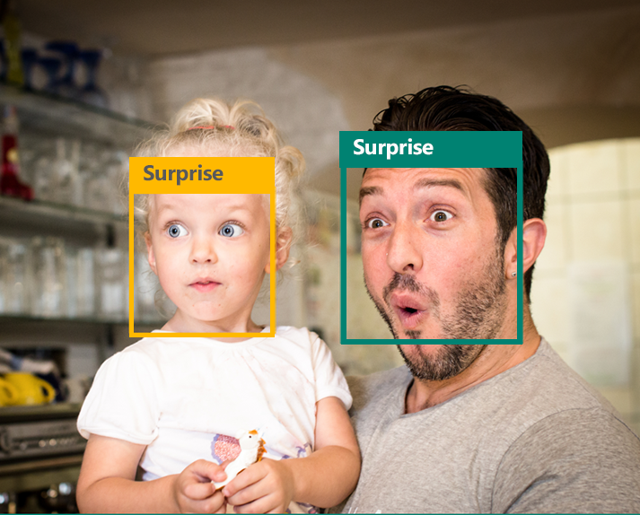
Emotion APIs
Face detection
"faceRectangle": {"width": 193, "height": 193, "left": 326, "top": 204} …
Emotion scores
“scores": { "anger": 5.182241e-8,
"contempt": 0.0000242813,
"disgust": 5.621025e-7,
"fear": 0.00115027453,
"happiness": 1.06114619e-8,
"neutral": 0.003540177,
"sadness": 9.30888746e-7,
"surprise": 0.9952837}

Slide 50

Face APIs
Face detection Detect faces and their attributes within an image
Face verification Check if two faces belong to the same person
Similar face searching Find similar faces within a set of images
Face grouping Organize many faces into groups
Face identification Search which person a face belongs to

Slide 51




Face APIs
Detection
"faceRectangle": {"width": 193, "height": 193, "left": 326, "top": 204}
…
Feature attributes
"attributes": { "age": 42, "gender": "male",
"headPose": { "roll": "8.2", "yaw": "-37.8", "pitch": "0.0" }}
Grouping
Identification
Jasper Williams

Slide 52


Video APIs
Stabilization Smooth and stabilize shaky video
Face detection and tracking Detect and track faces in videos
Motion detection Detect when motion occurs

Slide 53
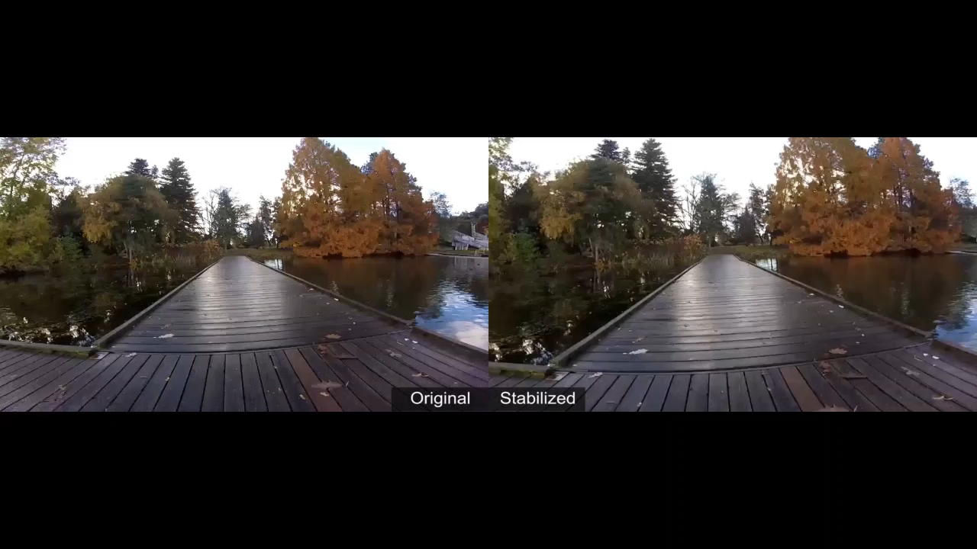
Stabilization
The Stabilization API provides automatic video stabilization and smoothing for shaky videos
This API uses many of the same technologies found in Microsoft Hyperlapse
Best For: Small camera motions, with or without rolling shutter effects (e.g., holding a static camera, walking with a slow speed)

Slide 54
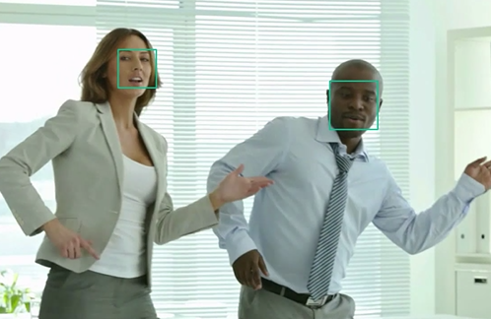
Face detection and tracking
High precision face location detection and tracking
Can detect up to 64 human faces in a video (no smaller than 24x24 pixels)
Detected and tracked faces are returned with coordinates and a Face ID to track throughout the video
Time (sec) | Face ID | x, y | Width, height
0 | 0 | 0.59, 0.23 | 0.09, 0.16
0 | 1 | 0.38, 0.15 | 0.07, 0.12
1 | 0 | 0.54, 0.25 | 0.09, 0.15
1 | 1 | 0.23, 0.18 | 0.07, 0.12

Slide 55
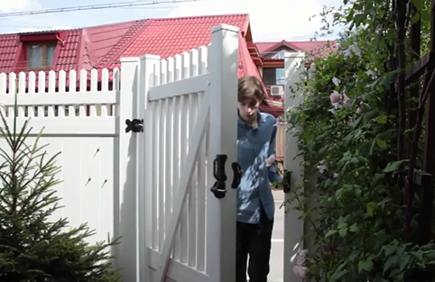
Motion detection
Indicates when motion occurs against a fixed background (e.g., surveillance video)
Trained to reduce false alarms, such as lighting and shadow changes
Current limitations:
No support for night-vision videos
Semi-transparent and small objects are not detected well
Start time | End time | In region
1.9 | 3.6 | 0
5.2 | 15.1 | 0

Slide 56
Speech
Hear and speak to your users by filtering noise, identifying speakers, and understanding intent
Bing Speech API
Speaker Recognition API
Custom Recognition Intelligent Service
Convert speech to text and back again, and understand its intent
Give your app the ability to know who's talking
Fine-tune speech recognition for anyone, anywhere

Slide 57

Speech APIs
Voice recognition (speech to text) Converts spoken audio to text
Voice output (text to speech) Synthesize audio from text
Speech intent recognition Convert spoken audio to intent

Slide 58
Voice recognition
REST API
Client library
SUPPORTED PLATFORMS
Any
Windows, Android, iOS
DATA SUPPORT
Yes
Yes
MIC SUPPORT
No
Yes
SILENCE DETECTION ON MIC
No
Yes
LENGTH OF UTTERANCE
Short
Short and long
NUMBER OF RESPONSES
n-best response back
Multiple partial results, n-best (short), and multiple phrases (long)
Supports 7 languages: en-US, en-GB, zh-CN, it-IT, fr-FR, es-ES, de-DE
Same technology that supports Microsoft offerings of Xbox, Windows, and Cortana

Slide 59
Voice recognition
Short form
Long form
Duration of Audio | < 15 seconds | < 2 minutes
Final Result | n-best choice | Best choice, delivered at sentence pauses
Partial Results | Yes | Yes
450 6th St. San Francisco
********* Final N-BEST Results *********
[0] Confidence=Normal Text="450 six St San Francisco."
[1] Confidence=Normal Text="For 50 six St San Francisco."
[2] Confidence=Normal Text="456th St San Francisco."
[3] Confidence=Normal Text="450 six St in San Francisco."
[4] Confidence=Normal Text="456 St San Francisco."

Slide 60
Voice output
Synthesize audio from text via POST request
Maximum audio return of 15 seconds
17 languages supported
<speak version="1.0" xmlns="http://www.w3.org/2001/10/synthesis" xmlns:mstts="http://www.w3.org/2001/mstts" xml:lang="en-US">
<voice name="Microsoft Server Speech Text to Speech Voice (en-US, ZiraRUS)">
Synthesize audio from text, to speak to your users.
</voice></speak>
Synthesize audio from text, to speak to your users

Slide 61

Custom Recognition
Customize both language and acoustic models Tailor speech recognition to your app and environment

Slide 62
Custom Recognition Intelligent Service
Create custom language models for the vocabulary of the application
Adapt acoustic models to better match the expected environment of the application’s users
Deploy to a custom endpoint and access from any device
Record
audio
Adapt
Deploy
Transcribe

Slide 63
Speaker recognition API
“”
Speaker verification Check if two voices are the same
Speaker identification Identify who is speaking

Slide 64
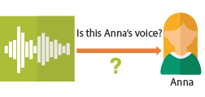
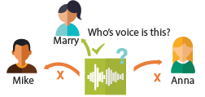
Speaker recognition APIs
“”
Enrollment
Create a unique voiceprint for a profile
Is this Anna’s voice?
Recognition
After enrolling one or more voices, identify who is speaking from an audio clip
Anna
Verification
Who’s voice is this?
Confirm if a voice belongs to a previously enrolled profile
Marry
Mike
Anna

Slide 65




Speech
Language
Process text and learn how to recognize what users want
Bing Spell Check API
Web Language Model API
Linguistic Analysis API
Language Understanding Intelligent Service
Text Analytics API
Detect and correct spelling mistakes within your app
Leverage the power of language models trained on web-scale data
Easily parse complex text with language analysis
Teach your apps to understand commands from your users
Detect sentiment, key phrases, topics, and language from your text

Slide 66

Bing spell check APIs
State-of-the-art cloud based spelling algorithms Recognizes a wide variety of spelling errors
Recognize name errors and homonyms in context Difficult to spot errors that use the context of the words around them
Updates over time Support for new brands and coined expressions as they emerge

Slide 67



Bing spell check APIs
Check a single word or a whole sentence
“Our engineers developed this four you!”
Corrected Text: “four” → “for”
Identify errors and get suggestions
"spellingErrors": [
{
"offset": 5,
"token": "gona",
"type": "UnknownToken",
"suggestions": [
{ "token": "gonna" }
] }

Slide 68

Language Understanding
Understand what your users are saying Use pre-built Bing and Cortana models or create your own

Slide 69
Language understanding intelligent service
Reduce labeling effort with interactive featuring
Use visualizations to gauge performance and improvements
Leverage speech recognition with seamless integration
Deploy using just a few examples with active learning
Define
concepts
Provide
examples
Deploy
Active learning

Slide 70
Language understanding models
{
“entities”: [
{
“entity”: “flight_delays”,
“type”: “Topic”
}
],
“intents”: [
{
“intent”: “FindNews”,
“score”: 0.99853384
},
{
“intent”: “None”,
“score”: 0.07289317
},
{
“intent”: “ReadNews”,
“score”: 0.0167122427
},
{
“intent”: “ShareNews”,
“score”: 1.0919299E-06
}
]
}
“News about flight delays”

Slide 71
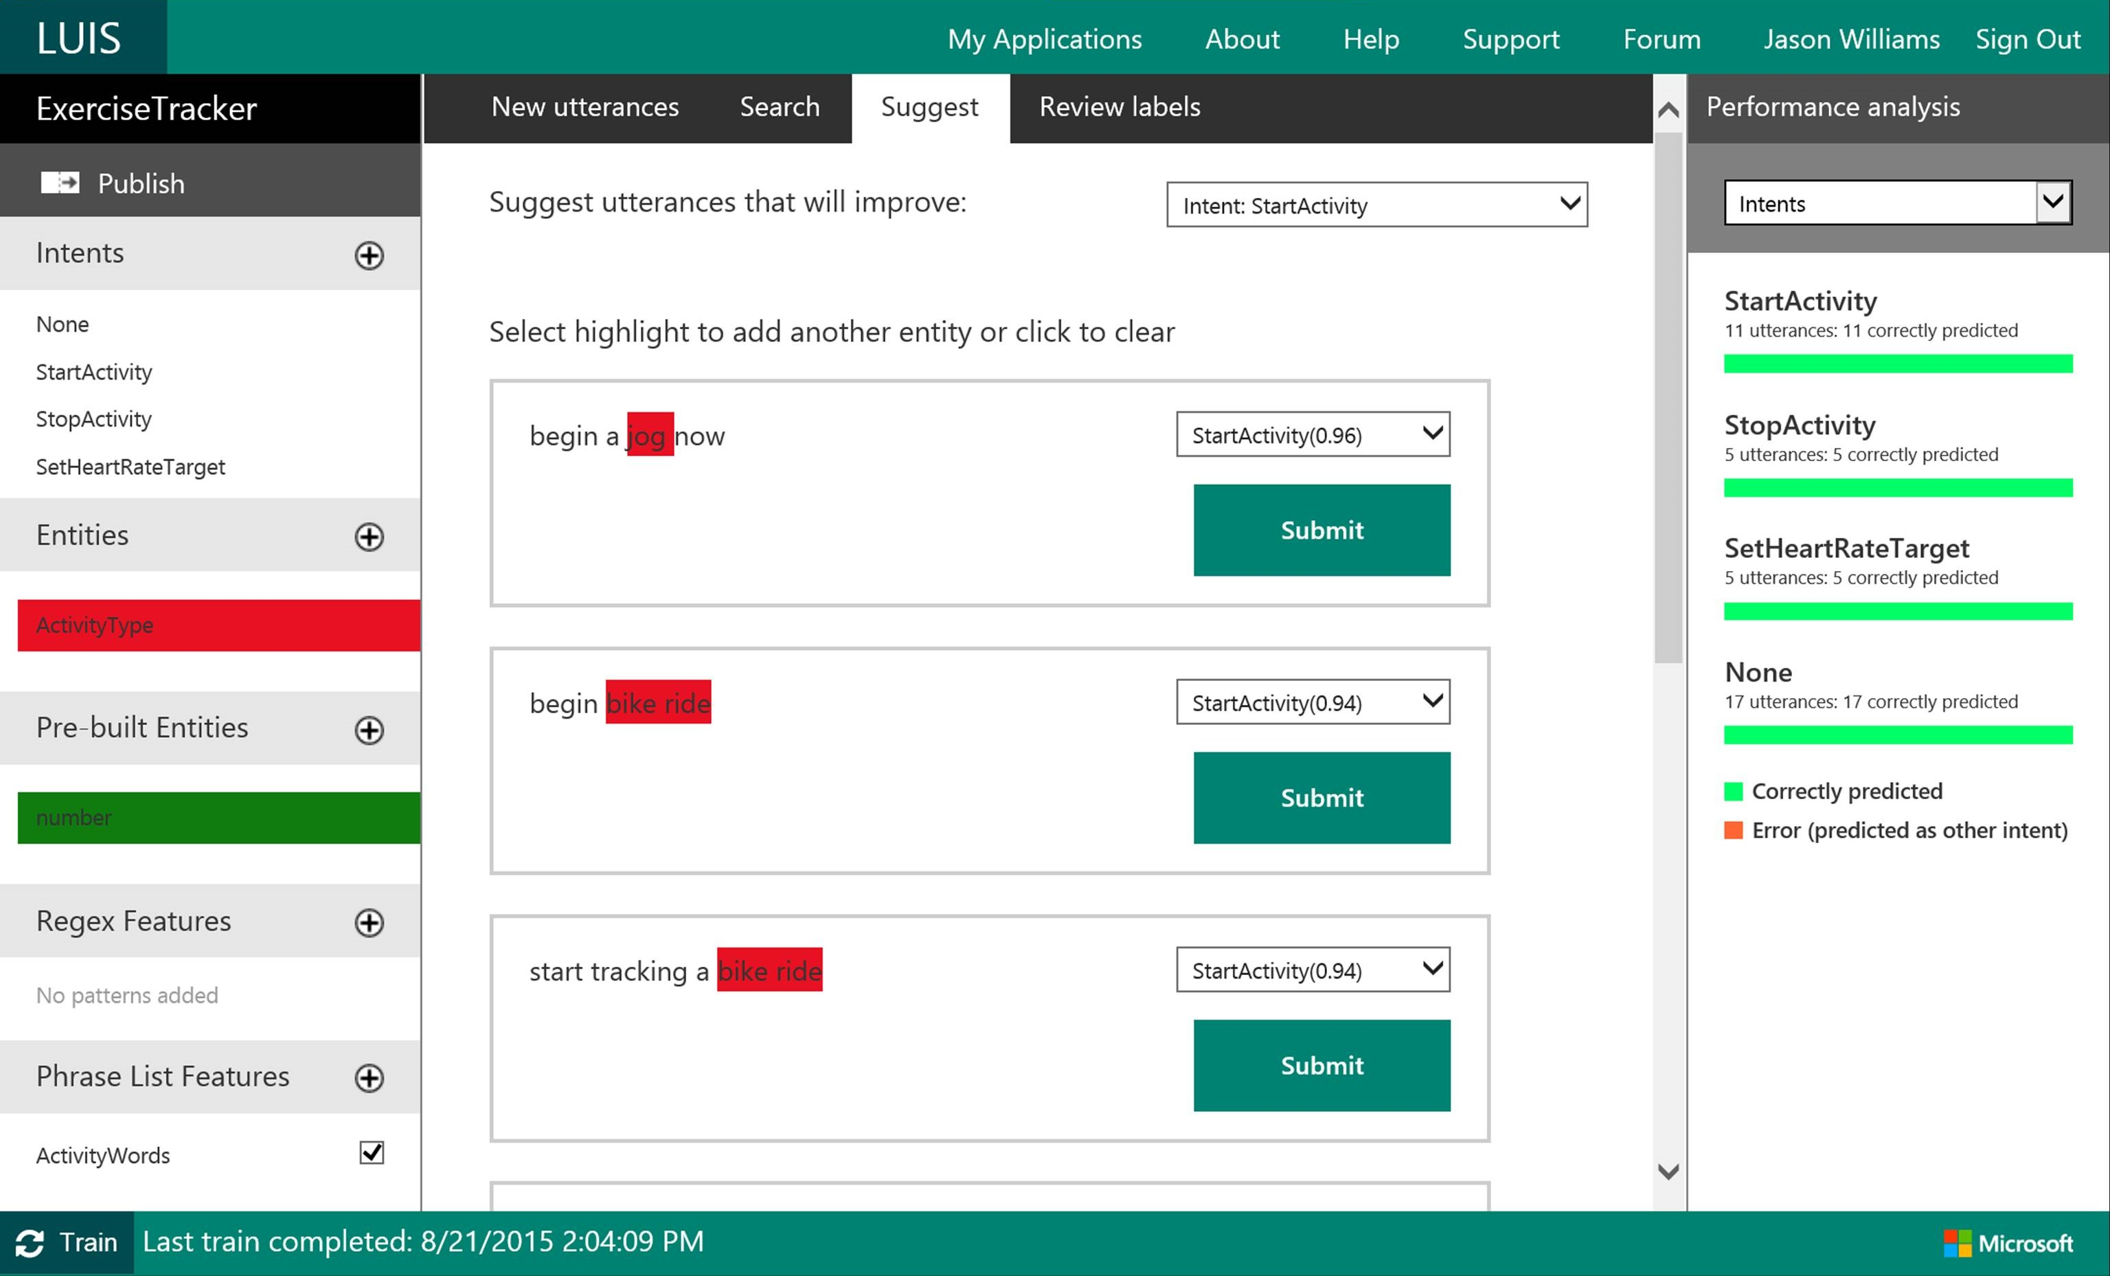

Slide 72

Linguistic analysis
Analysis tolls for natural language processing Access to part-of-speech tagging and parsing, identifying concepts, and actions

Slide 73
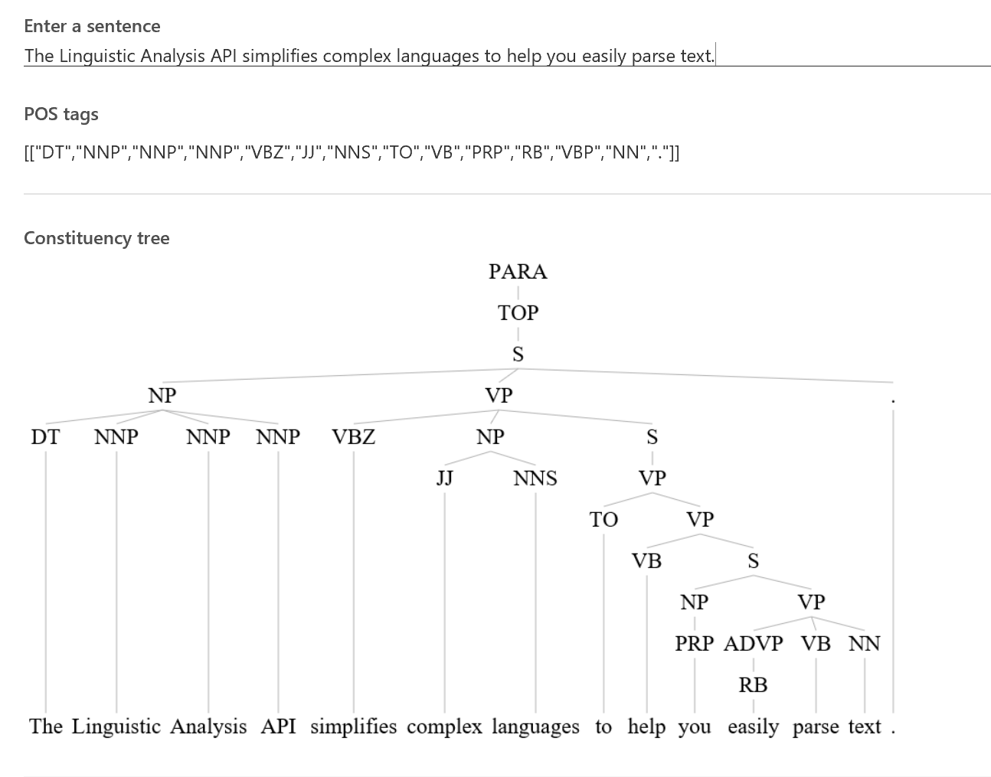
Linguistic Analysis

Slide 74

Text analytics
Sentiment analysis Understand if a record has positive or negative sentiment
Key phrase extraction Extract key phrases from a piece of text, and retrieve topics
Topic detection Use clustering techniques to identify the trending topics on a large set of text records
Language detection Identify the language, 120 supported languages

Slide 75

Web language model
Automation of a variety of standard natural language processing tasks using state-of-the-art language modeling APIs
Word breaking, joint probability of natural language expressions, scoring, and predicting following words in a sequence

Slide 76

Language
Knowledge
Tap into rich knowledge amassed from the web, academia, or your own data
Academic Knowledge API
Knowledge Exploration Service
Entity Linking Service
Recommendations API
Explore relationships among academic papers, journals, and authors
Add interactive search over structured data to your project
Contextually extend knowledge of people, locations, and events
Provide personalized product recommendations for your customers

Slide 77

Academic knowledge
Interpret Interprets a natural language user query string. Returns annotated interpretations which can enable rich search-box auto-completion experiences that anticipate what the user is typing
Evaluate Evaluates a query expression and returns academic knowledge entity results
Calchistogram Calculates a histogram of the distribution of attribute values for the academic entities returned by a query expression, such as the distribution of citations by year for a given author

Slide 78

Entity linking
Power your app's data links with named entity recognition and disambiguation A word might be used as a named entity, a verb, or another word form within a given sentence
The Entity Linking Intelligence Service will recognize and identify each separate entity based on the context

Slide 79

Knowledge exploration Enable interactive search experiences over structured data via natural language inputs
Attribute histograms To enable rich visualization and interactive faceted experience
Structured query evaluation To efficiently retrieve detailed information about matching objects
Query auto-completion
To reduce user effort and help with discovery of rich capabilities
Natural language understanding
To interpret natural language queries into structured query expressions

Slide 80


Recommendations
Increase catalog discovery Help customers easily discover items that they may be interested in
Personalize your experience Show suggestions that are targeted to each specific user
Increase the bottom line Increase your conversion rate by offering the right products at the right time

Slide 81
Search
Knowledge
Access billions of web pages, images, videos, and news with the power of Bing APIs
Bing Web Search API
Bing Autosuggest API
Bing Image Search API
Bing Video Search API
Bing News Search API
Connect powerful search to your apps
Give your app intelligent autosuggest options for searches
Bring advanced image and metadata search to your app
Trending videos, detailed metadata, and rich results
Link your users to robust and timely news searches

Slide 82

Bing web search
Intelligent search to your apps with the ability to comb billions of webpages, images, videos, and news with a single API call Retrieve web documents indexed by Bing and narrow the results down with filters such as by answer type and freshness

Slide 83

Bing image search
A variety of image search options, from trending images to detailed insights Scour the web for images and get results that include thumbnail and full image URLs, publishing website, image metadata, related images, and more

Slide 84

Bing video search
A variety of advanced video search features, including trending videos, price, and other useful metadata Find videos from across the web and get responses that provide useful metadata including creator, encoding format, video size and quality, and source view count

Slide 85

Bing news search
Turn any app into a news desk with world news grouped and filtered by topic, local news, and metadata you can mine

Slide 86

Bing auto suggest
[
Query completion suggestions capabilities, so users can type less and get to what they want faster

Slide 87
Demo

Slide 88
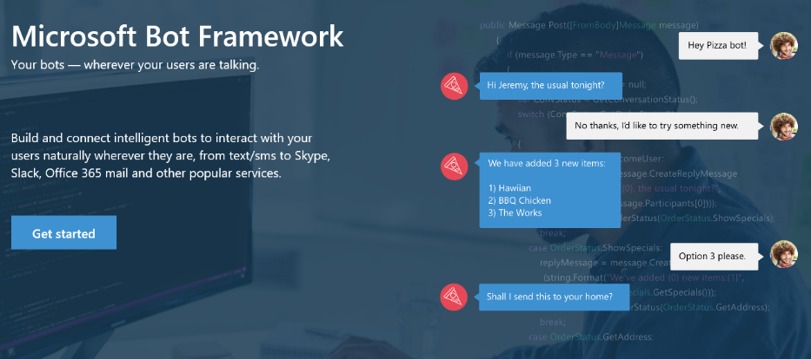
Your bots – wherever your users converse
Intelligence
Cognitive Services
Bot Framework
Cortana
Bot Connector Service: A service to register your bot, configure channels and publish to the Bot Directory. Connect your bot(s) seamlessly to text/sms, Office 365 mail, Skype, Slack, Twitter, and more.
Bot Builder SDK: An open source SDK hosted on GitHub. Everything you need to build great dialogs within your Node.js or C# bot
Bot Directory: A public directory of bots registered through the Bot Connector Service. Discover, try, and add bots to conversation experiences

Slide 89

Get things done in more helpful, proactive and natural ways
Here are some of the things I can help you with…
Cortana for Consumers (today)
With the Cortana Intelligence Suite
Intelligence
Cognitive Services
Answers
Public reference data answers – “How far is it from Los Angeles to San Francisco?”
Answers from organizational data in Power BI
“What were our biggest deals that closed last month?”
Bot Framework
Predictions
Event predictions – “Who do you think is going to win the Germany Italy game?”
Integration with prediction solutions
“Which of our customers are most likely to churn in the next quarter?”
Cortana
Monitoring & Alerts
Flight status, traffic conditions, changes in weather, …
Monitoring KPIs and preemptive alerting
“Alert me if this customer ever has a 90% chance of churn in the next 30 days”
Task Completion
Setting reminders, scheduling meetings, getting directions, …
Line of business process integration
Assistance with expense report submission on-time within policy

Slide 90



Dashboards & Visualizations
Information Management
Big Data Stores
Machine Learning and Analytics
Intelligence
Data Sources
Data Factory
Data Lake Store
Machine Learning
Cognitive Services
Data Catalog
SQL Data
Warehouse
Data Lake Analytics
Bot Framework
Apps
HDInsight
(Hadoop and Spark)
Event Hubs
Cortana
Sensors and devices
Stream Analytics
Dashboards & Visualizations
Power BI
Data
Data
Intelligence

Slide 91
Q&A

Slide 92

© 2016 Microsoft Corporation. All rights reserved.

Slide 93
Appendix

